Slide 1
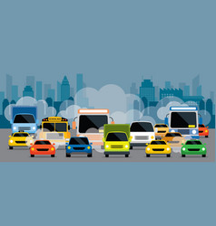
Pollution detection using image processing
Sanjana, A2305220739
Department of Computer Science Engineering
Notes:
NOTE:
To change the image on this slide, select the picture and delete it. Then click the Pictures icon in the placeholder to insert your own image.

Slide 2
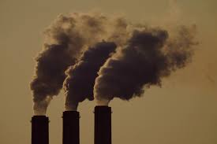
1. Air Pollution-Introduction
Air pollution refers to the release of pollutants into the air—pollutants which are detrimental to human health and the planet as a whole.
There are two types of pollutants-primary and secondary.
Different types of particles follow different trend in their concentration in various seasons
Some organizations that keeps in check their concentration-
(a) IMPROVE, NWA
(b) NAQM

Slide 3
2. Types of approaches
Parameters | Machine Learning | Deep Learning | Image processing
About | Machine learning is an utilization of artificial intelligence (AI) that enable the systems to learn explicitly and enhance the output from experience | Deep Learning is a subfield of machine learning concerned with algorithms inspired by the structure and function of the brain called artificial neural networks | Image processing is an effective method of converting an image, perform some necessary operation upon it, and extract useful information accordingly
2. Accuracy level | Very good | Best | good
3. Cost | expensive | Most expensive due to huge set of database | Least expensive and no dataset required
4. Area covered | Large area | Large area | Particular area where the camera is placed and can move.

Slide 4
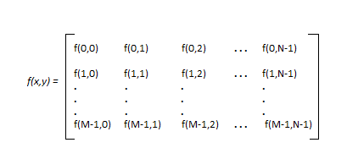
3. Methodology used
3.1. Digital image
An image is defined as a two-dimensional function,F(x,y), where x and y are spatial coordinates, and the amplitude of F at any pair of coordinates (x,y) is called the intensity of that image at that point. When x,y, and amplitude values of F are finite, we call it a digital image.
Each pixel contains 3-bytes values that determines the value of that pixel. Red, blue and green are chosen as three primary colours
Total 16.8 million combinations are possible but we take 266 values between 0 and 255 which make 0.39% of total colors visible to human eye.
Figure 1-Digital image as matrix

Slide 5
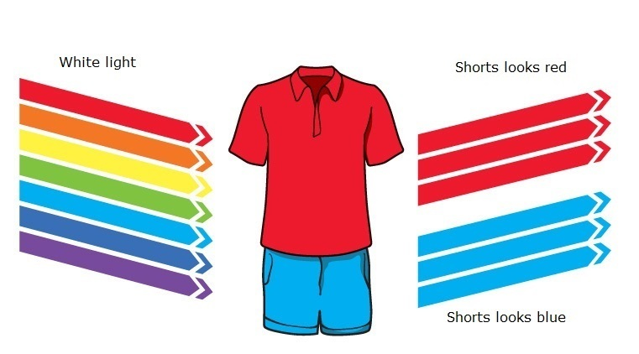
3. Methodology used
3.2. Light and Visibility
The collision of light particle with any other particle can result in any of these phenomenon-absorption, reflection, scattering or transmission of light.
When light collides with particle of
Less wavelength-reflection
High wavelength-absorption and refraction
The colour of photons then reflected by that object captured determines the colour which we see in that object.
Figure 2- Human eye visibility

Slide 6
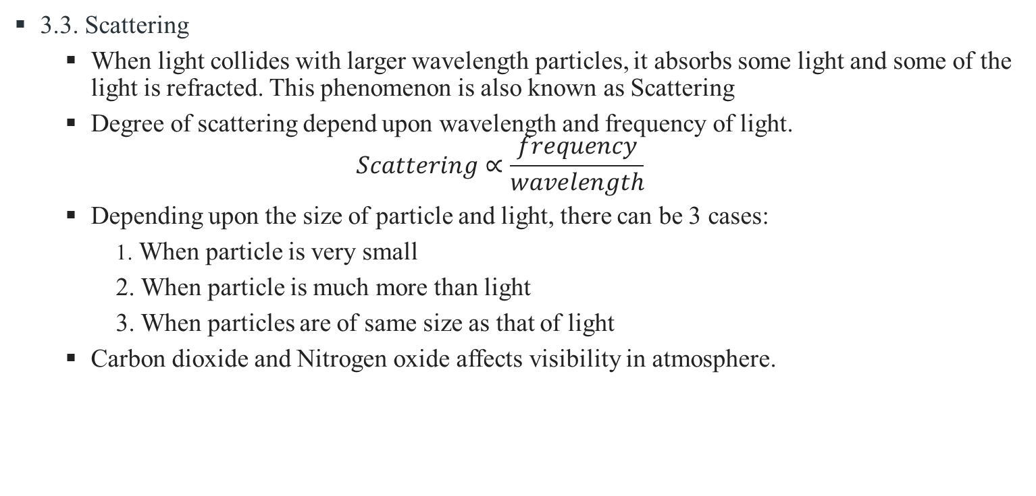
3. Methodology used
3.3. Scattering
When light collides with larger wavelength particles, it absorbs some light and some of the light is refracted. This phenomenon is also known as Scattering
Degree of scattering depend upon wavelength and frequency of light.
$$Scattering∝\frac{frequency}{wavelength}$$
Depending upon the size of particle and light, there can be 3 cases:
1. When particle is very small
2. When particle is much more than light
3. When particles are of same size as that of light
Carbon dioxide and Nitrogen oxide affects visibility in atmosphere.

Slide 7

3. Calculation
(A) Variance
${\hat{σ}}_{R^{′}}^{2}=\frac{\sum_{c=0}^{c−1}{\sum_{r=0}^{r−1}{\left({R^{′}}_{cr}\right.}}{{− \overline{R^{′}})}^{2}}}{RC−1}$
${\hat{σ}}_{G}^{2}=\frac{\sum_{c=0}^{c−1}{\sum_{r=0}^{r−1}{\left(G_{cr}\right.}}{{− \overline{G})}^{2}}}{RC−1}$
${\hat{σ}}_{B}^{2}=\frac{\sum_{c=0}^{c−1}{\sum_{r=0}^{r−1}{\left(B_{cr}\right.}}{{− \overline{B})}^{2}}}{RC−1}$
(B) Covariance
${\hat{σ}}_{R^{′}G}=\frac{\sum_{c=0}^{c−1}{\sum_{r=0}^{r−1}{\left({R^{′}}_{cr}\right.}}{− \overline{R^{′}})(G_{cr}− \overline{G})}}{RC−1}$
${\hat{σ}}_{R^{′}B}=\frac{\sum_{c=0}^{c−1}{\sum_{r=0}^{r−1}{\left({R^{′}}_{cr}\right.}}{− \overline{R^{′}})(B_{cr}−\overline{B})}}{RC−1}$
${\hat{σ}}_{GB}=\frac{\sum_{c=0}^{c−1}{\sum_{r=0}^{r−1}{\left(G_{cr}\right.}}{− \overline{G})(B_{cr}−\overline{B})}}{RC−1}$

Slide 8

3. Calculation
(C) Covariance matrix
$\sum{= \begin{matrix}{\hat{σ}}_{R^{′}}^{2} & {\hat{σ}}_{R^{′}G} & {\hat{σ}}_{R^{′}B} \\ {\hat{σ}}_{GR^{′}} & {\hat{σ}}_{G}^{2} & {\hat{σ}}_{GB} \\ {\hat{σ}}_{BR^{′}} & {\hat{σ}}_{BG} & {\hat{σ}}_{B}^{2}\end{matrix}}$
(D) Correlation
$ρ_{R^{′}G}=\frac{{\hat{σ}}_{R^{′}G}}{\sqrt{{\hat{σ}}_{R^{′}}^{2}∗{\hat{σ}}_{G}^{2}}}$
$ρ_{R^{′}B}=\frac{{\hat{σ}}_{R^{′}B}}{\sqrt{{\hat{σ}}_{R^{′}}^{2}∗{\hat{σ}}_{B}^{2}}}$
$ρ_{GB}=\frac{{\hat{σ}}_{GB}}{\sqrt{{\hat{σ}}_{G}^{2}∗{\hat{σ}}_{B}^{2}}}$
(E) standard deviation- Calculated using square root of covariance

Slide 9
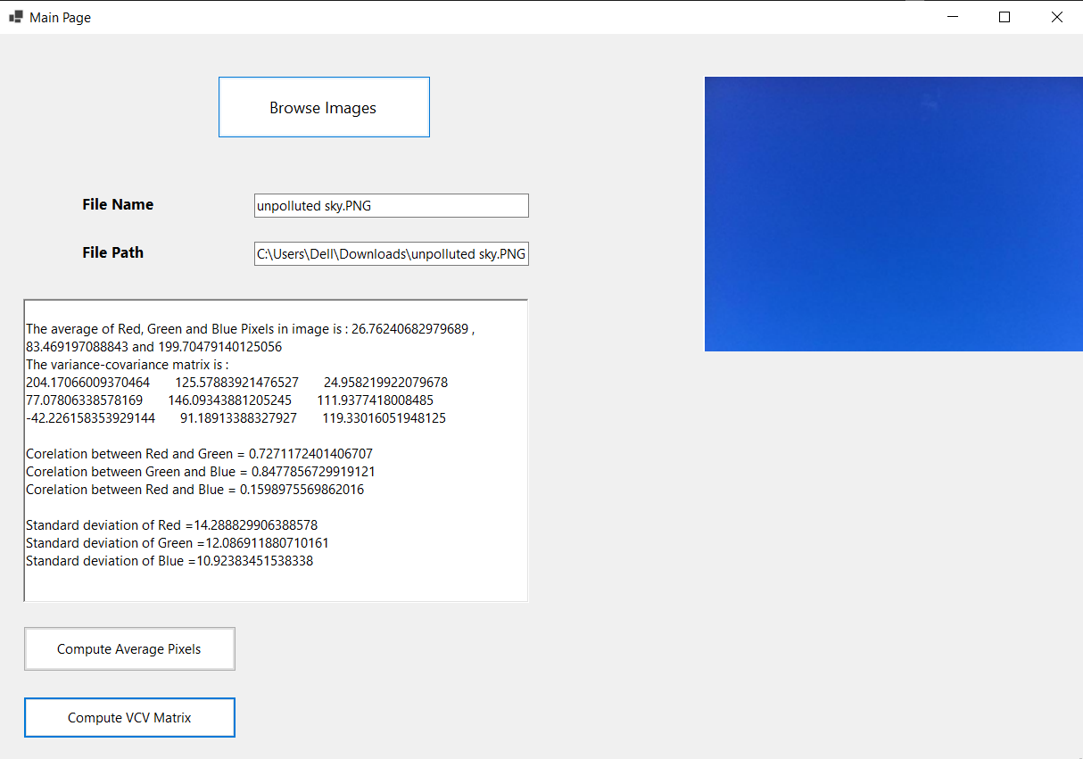
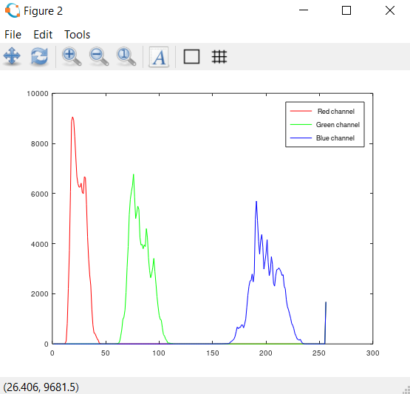
4. Observations and result
1. For unpolluted image

Slide 10
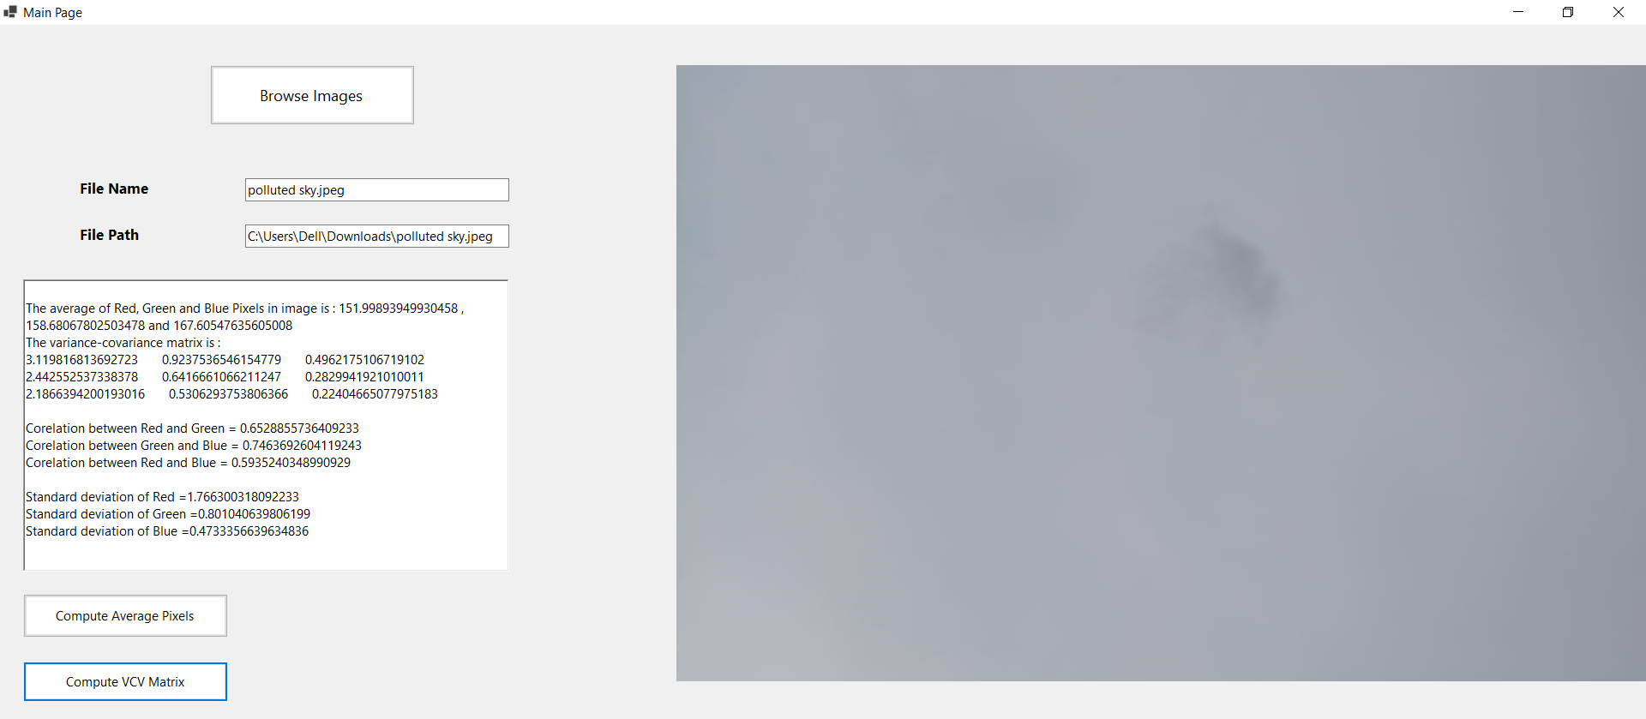
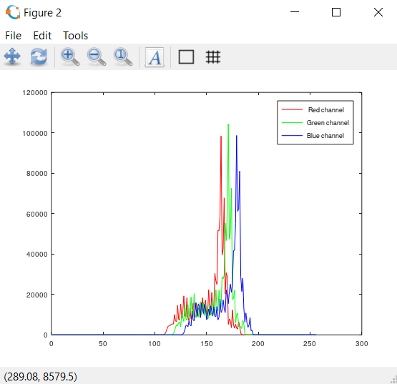
4. Observations and result
2. For polluted image

Slide 11
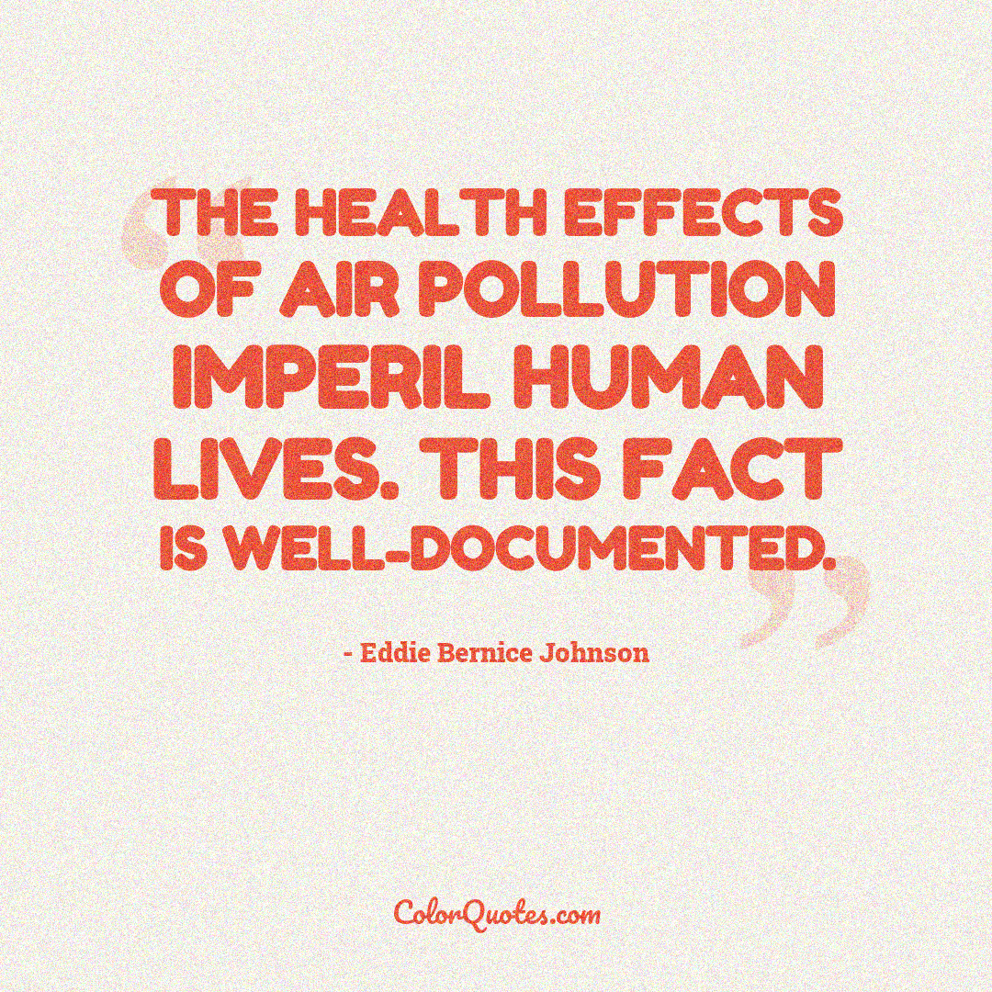
5. Conclusion
According to WHO, nine out of ten people breathes polluted air in today’s world and this causes death of 7 million people each year
It causes harm to human health and environment
We can monitor air pollution level of our environment with digital images.

Slide 12
References
Sultana, Samia. "A Comparison Study of Air Pollution Detection using Image Processing, Machine Learning and Deep Learning Approach." Global Journal of Computer Science and Technology (2019).
Amritphale, Amrita Nikhil. "A digital image processing method for detecting pollution in the atmosphere from camera video." (2013).

Slide 13
THANK YOU

